Slide 1
Growth

Slide 2
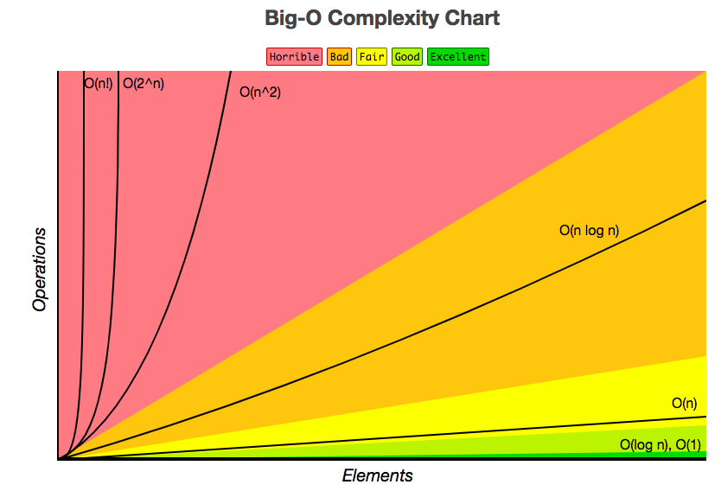
Θ(1) < Θ(log n) < Θ(n) < Θ(nlogn) < Θ(n²) < Θ(n³) < Θ(2^{n})
Don’t worry about the O notation in the graph

Slide 3
Drop Lower Terms, Drop Constants
Θ(n³+3n²+5^{n}+10) → Θ(n³)
Θ(234324231n²) → Θ(n²)
Θ(n) + Θ(n) → ??

Slide 4
Drop Lower Terms, Drop Constants
Θ(n³+3n²+5^{n}+10) → Θ(n³)
Θ(234324231n²) → Θ(n²)
Θ(n) + Θ(n) → Θ(2n) # drop constant
= Θ(n)

Slide 5
Θ(1)

Slide 6
Θ(1)
+,-,/,%,*,//
Variable assignments
>,<,==,<=,>=
print()
and,or
def constant(n):
return (n + 32342) // n
*Creds to Sequoia’s Textbook
No matter how big an input, it still takes the same time to compute

Slide 7
Θ(log n)
How many times will I loop over the while loop until it stops?
def divide(n):
while n > 0:
print(“log n”)
n = n // 2
>>> divide(2)
>>> divide(4)
log n
log n
log n
log n
log n
>>> divide(5)
>>> divide(8)
log n
log n
log n
log n
log n
log n
log n
log n
log n
log n

Slide 8
Θ(n)
For every integer in [0, ... , m), print it once
def n(m):
for i in range(m):
print(i)

Slide 9
Θ(n²)
Nested for loop: outer loop runs in Θ(n), inner loop runs in Θ(n). Θ(n) * Θ(n) = Θ(n²)
def n(m):
for i in range(m):
for j in range(m):
print(i, j)
>>> n(3)
0 0
0 1
0 2
1 0
1 1
1 2
2 0
2 1
2 2

Slide 10
Θ(?)
def n(m):
for i in range(m):
for j in range(i):
print(i, j)

Slide 11
def n(m):
for i in range(m):
for j in range(i):
print(i, j)
Θ(n²)

Slide 12
Extra: Runtime in Numerical
Input Size (n) | Θ(1) | Θ(log n) | Θ(n) | Θ(n²)
1 | 1 | 1 | 1 | 1² = 1
4 | 1 | 2 | 4 | 4² = 16
16 | 1 | 4 | 16 | 16² = 256
1024 | 1 | 10 | 1024 | 1024² = 1048576
Runtime remains the same even though input size increases
Input size increases, initially takes lots of work and then less work each input
Runtime is exponentially proportional to the input size
Runtime is directly proportional to the input size
Data source from here

Slide 13
Helpful Resources
Owen’s Growth Slides
Yichen’s Growth Guide
Many more...(look at Resources tab)

